Slide 1
How to avoid following a precedent?

Slide 2
What can a judge do when there is a previous case which sets a precedent?
Distinguish their current case (open to all levels of court)
Overrule the decision in the previous case (only open to judges in courts HIGHER than the original decision)
For the Supreme Court only – use the practice statement 1966
For the Court of Appeal only considering its own previous cases – follow the decision in Young v Bristol Airplane

Slide 3
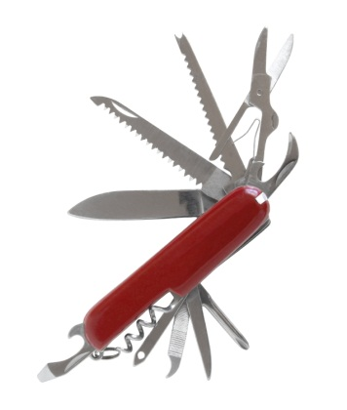
Distinguishing
R v Brown House of Lords
R v Wilson Court of Appeal
The CA felt able to avoid following Brown and found Mr Wilson ‘not guilty’ because they said the facts were sufficiently different. The case of Brown remains the law for all cases with similar facts.

Slide 4
Overruling a previous decision
A v Hoare
Overruled Stubbings v Webb
…to allow women who had been sexually attacked / abused by men when they were younger to sue them after the usual ‘limitation’ period had expired

Slide 5
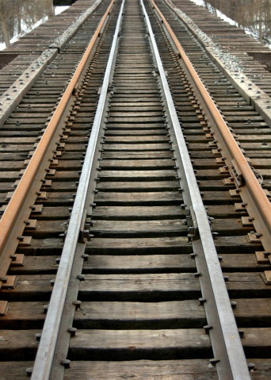
Supreme court using the practice statement 1966 ‘when it appears right to do so’
Addie v Dumbreck 1929
BRB v Herrington 1972
The Later case allowed child trespassers injured while trespassing on a railway track to sue successfully. The House of Lords used the Practice Statement to overrule the previous decision because the times had changed and attitudes had changed towards child trespassers since 1929.

Slide 6
Court of Appeal
In Young v Bristol Aeroplane
3 options
If there are 2 conflicting previous decisions of the Court of Appeal – CHOOSE which one to follow (R v Parmenter CA chose to follow R v Spratt which was heard on the same day as R v Savage but had a different result – When R v Parmenter went to the House of Lords they overruled Spratt instead!!!)
If the Supreme Court has already made a decision that contradicts the CA case – FOLLOW the Supreme Court
If the previous decision was made ‘per incuriam’ – they can change the decision to correct a mistake in the law made in the previous decision.

Slide 7
Example of CA choosing a previous case to follow….
PROBLEM: there was uncertainty as to whether a person needed to foresee harm to someone they injured in order to be guilty of s.47 actual bodily harm;
R v Spratt (CA) said YES R v Savage (CA) said NO
Both were Court of Appeal cases decided on the same day…
In R v Parmenter (CA) chose to follow Spratt at first but the House of Lords later confirmed that Savage was correct.

